Slide 1
Face Recognition
Presenters’ Names:
Rahul Sampagaon
Roshan Mangalani
Dhanasekar Ravi Jayanthi

Slide 2
Challenges
Not enough images
Images of different sizes
Not properly cropped
Solution
Data Preprocessing: Image augmentation and cleaning

Slide 3
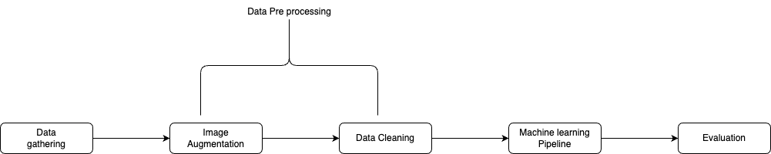
Workflow

Slide 4
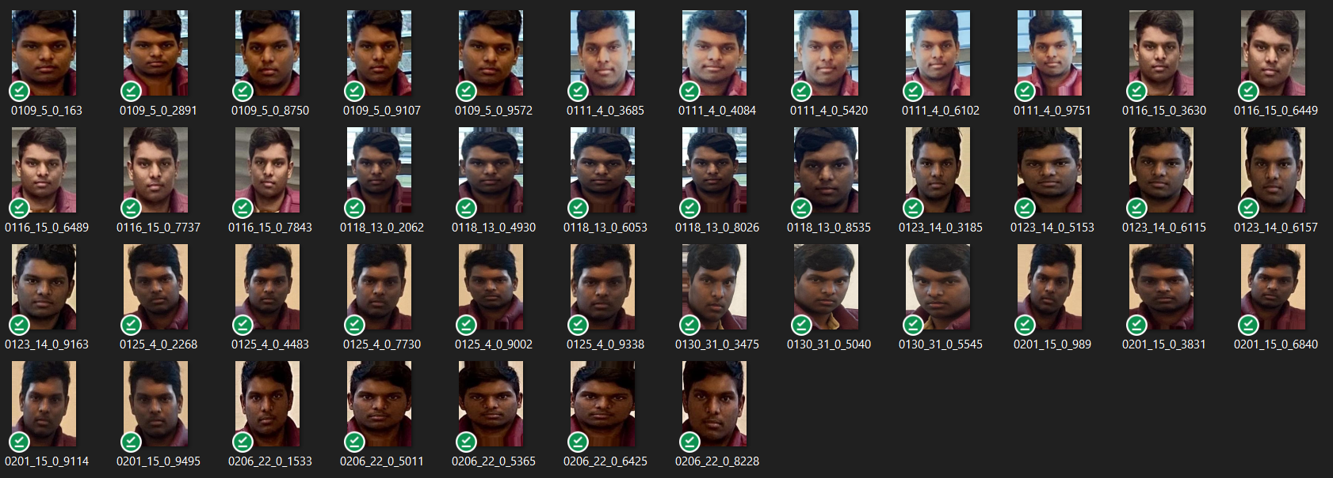
Image Augmentation
Goal is to generate quantity and diversity in dataset

Slide 5
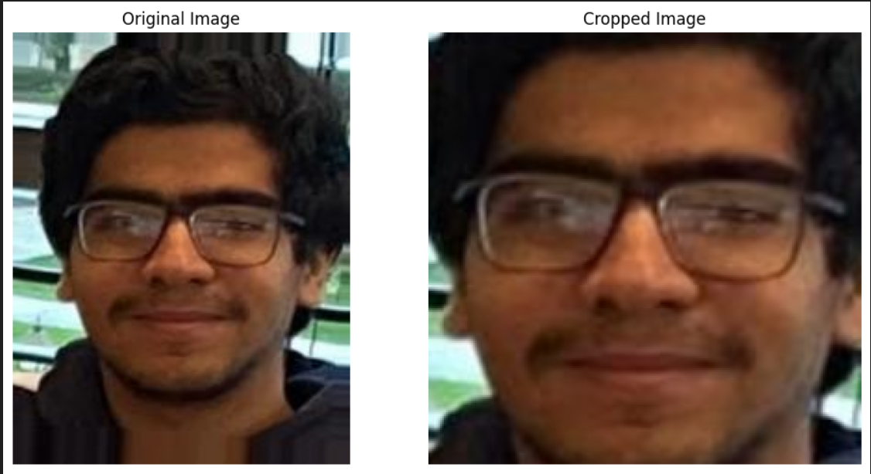
Face Detection and cropping
Detect the face in the image and crop the image only to that face
Helps remove unwanted background features which could present themselves as noise
Used DeepFace for face extraction

Slide 6
Building The Model

Slide 7
Importance of Preprocessing
SVM accuracy without Augmentation - 0.335
SVM accuracy with Augmentation - 0.658

Slide 8
Feature Extraction
Extract features from the image data which are to be fed to the ML model
PCA
LDA
HOG

Slide 9
Machine Learning Pipeline
Pipeline model used with 4 stages
Standard scaler
PCA
LDA
SVM

Slide 10
Results
Model | Accuracy
SVM without augmentation | 0.335
SVM | 0.658
lda + svm | 0.838
lda + knn | 0.845
pca + lda + knn | 0.858
Scaler + pca + lda + svm | 0.916

Slide 11
Key Learnings
Data preprocessing - proper techniques can double your accuracy
Feature Extraction - PCA before any traditional algorithm (svm, knn,..) reduces the training time
Model selection - SVM model outperformed knn, naive bayes and others

Slide 12
Questions?

Slide 13
Thank you

